Slide 1

Olist Marketing & E-Commerce

Slide 2
Table of contents
1
4
2
5
3
6
Project Outcome
Introduction
Recommendation
Data Analysis
Machine Learning
Conclusion

Slide 3
1
Introduction

Slide 4
Introduction - Problem Statement
To analyse sales trends and evaluate present revenue
To explore provided data to suggest marketing strategies for subsequent increase in revenue

Slide 5
2
Data Analysis & Visualisation

Slide 6
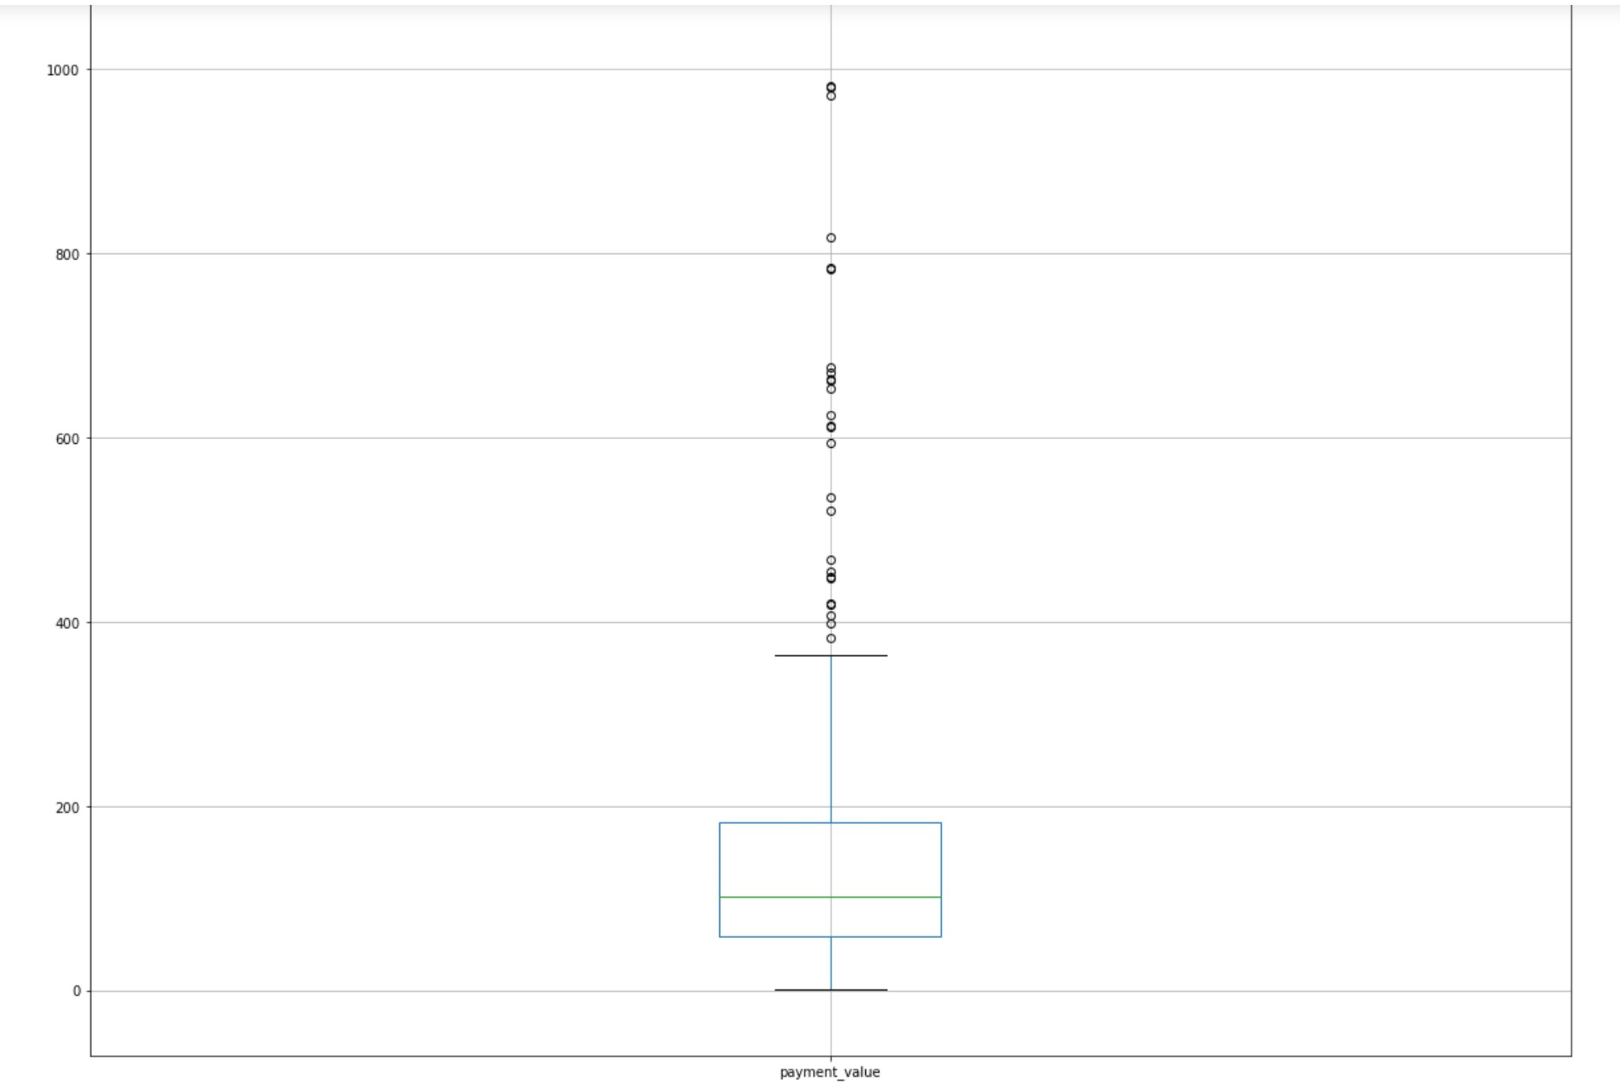
Box Plot of Payment Values for 2016

Slide 7
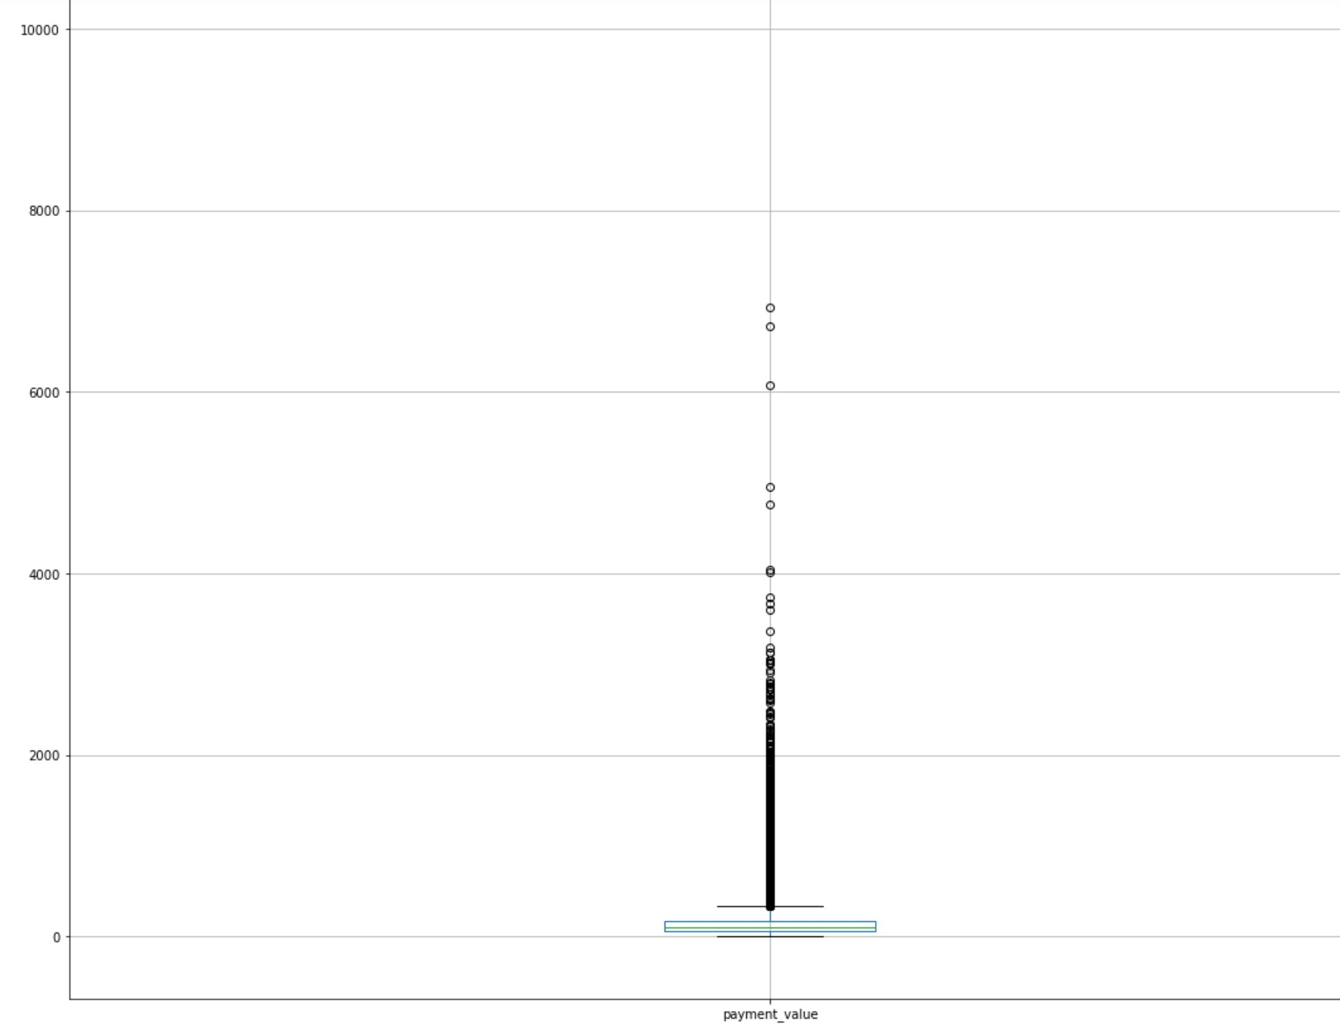
Box Plot of Payment Values for 2017

Slide 8
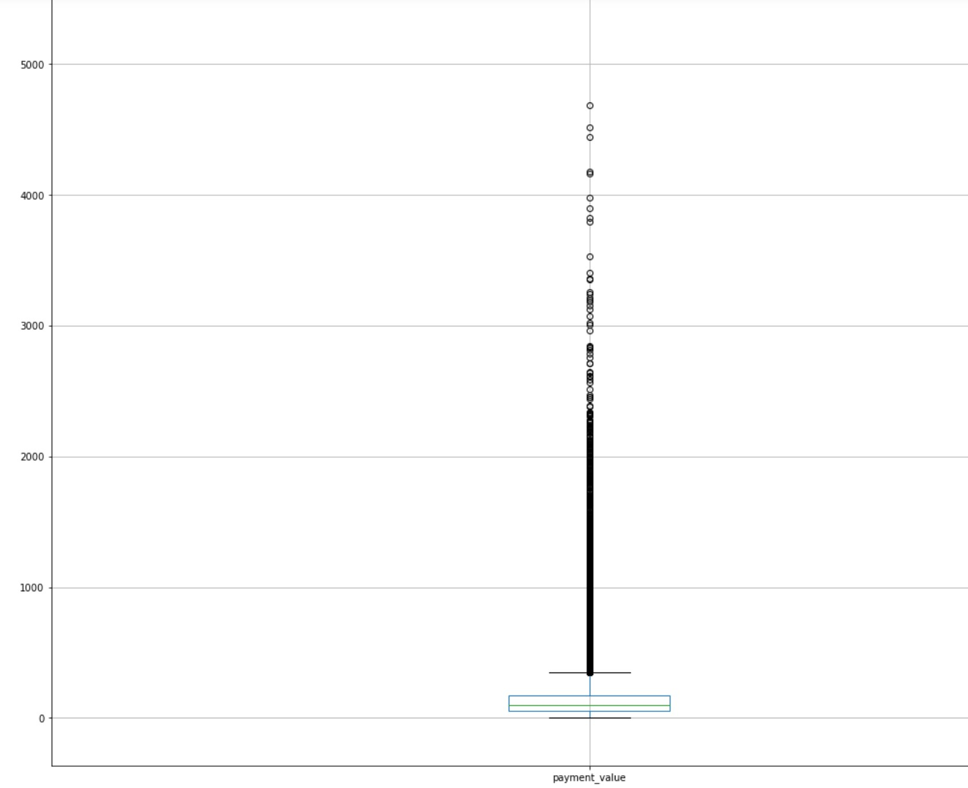
Box Plot of Payment Values for 2018

Slide 9
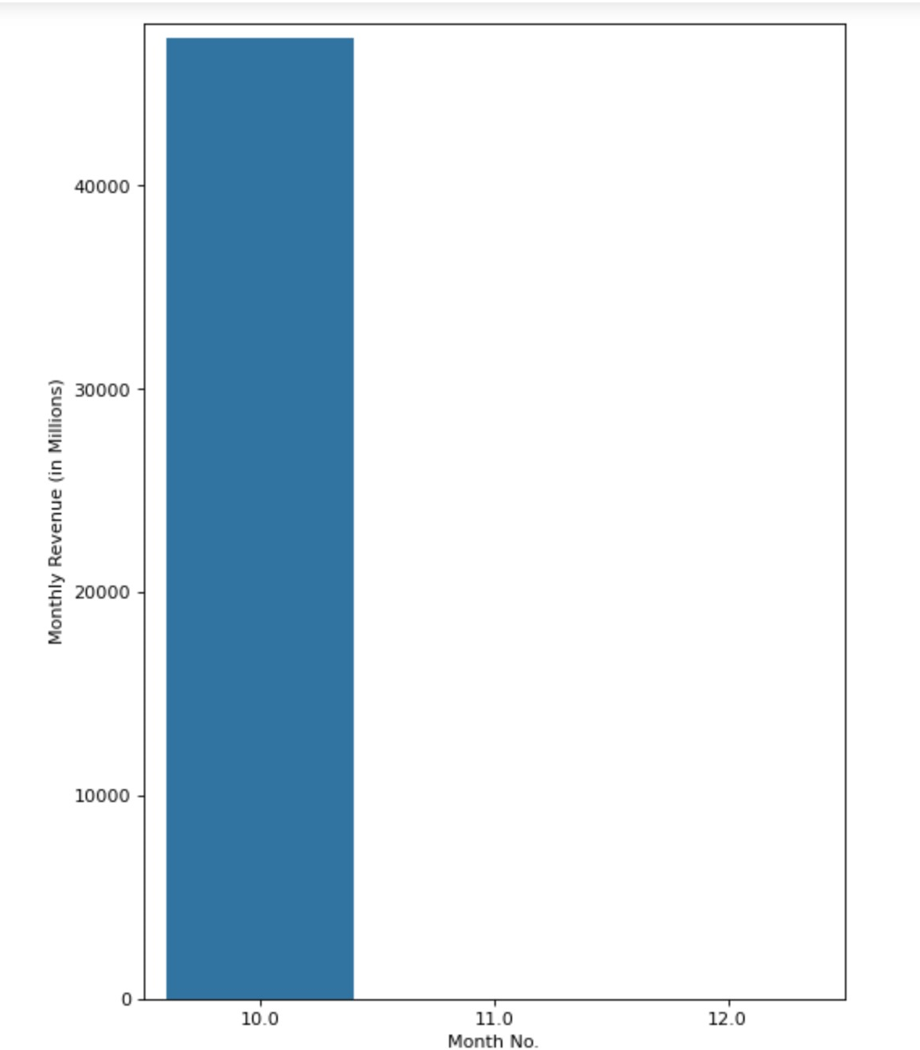
Bar Graph representing Monthly Revenue for 2016

Slide 10
Exploratory Data Analysis for 2016
Month with the Highest Revenue
Month with the Least Revenue
OCTOBER NOVEMBER
(47271.20) (0.0)

Slide 11
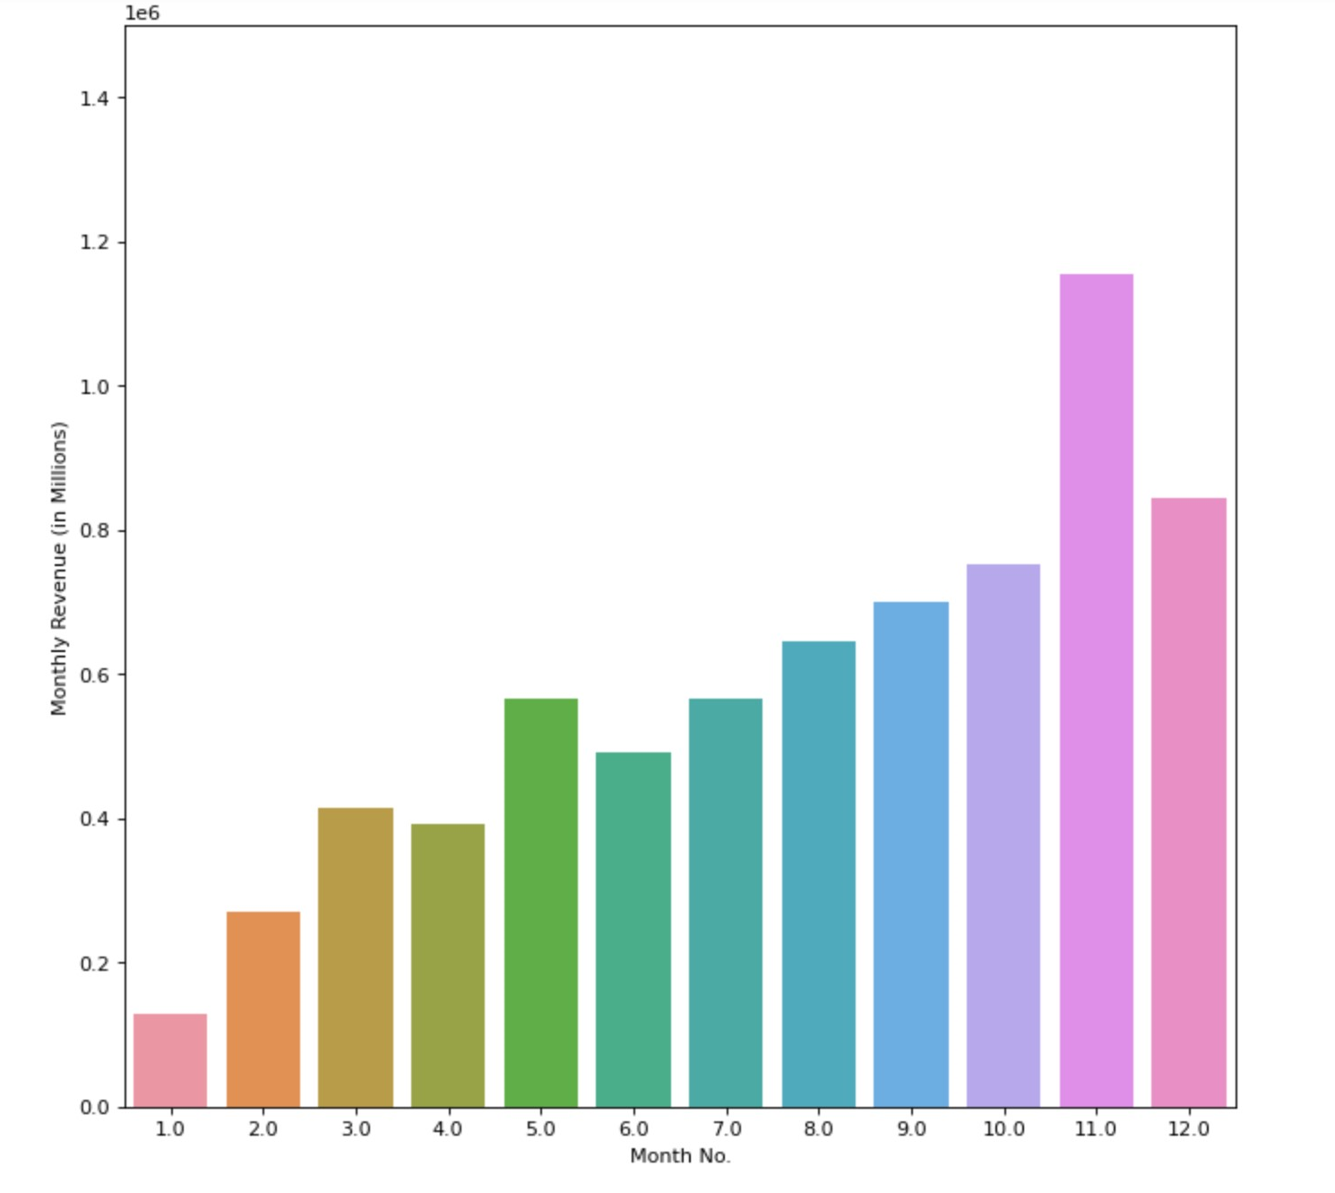
Bar Graph representing Monthly Revenue for 2017

Slide 12
Exploratory Data Analysis for 2017
Month with the Highest Revenue
Month with the Least Revenue
NOVEMBER JANUARY
(1153393.22 ) (127414.12 )

Slide 13
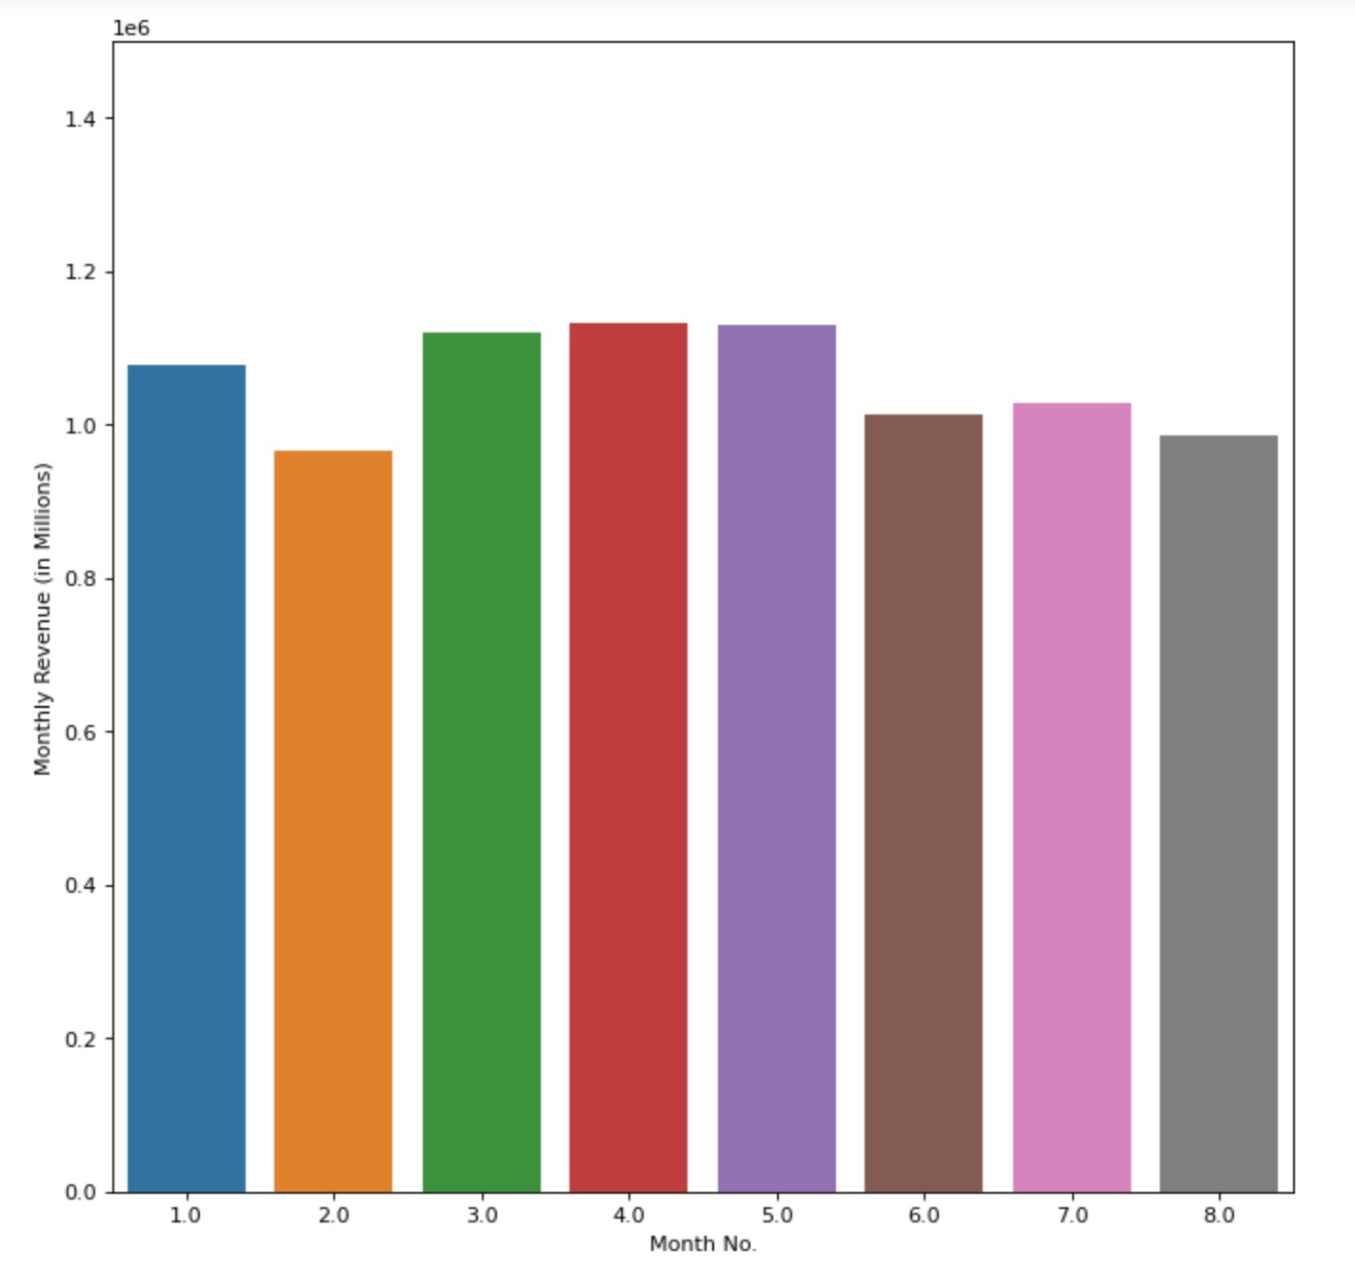
Bar Graph representing Monthly Revenue for 2018

Slide 14
Exploratory Data Analysis for 2018
Month with the Highest Revenue
Month with the Least Revenue
APRIL FEBRUARY
(1132933.95) (966554.95)

Slide 15
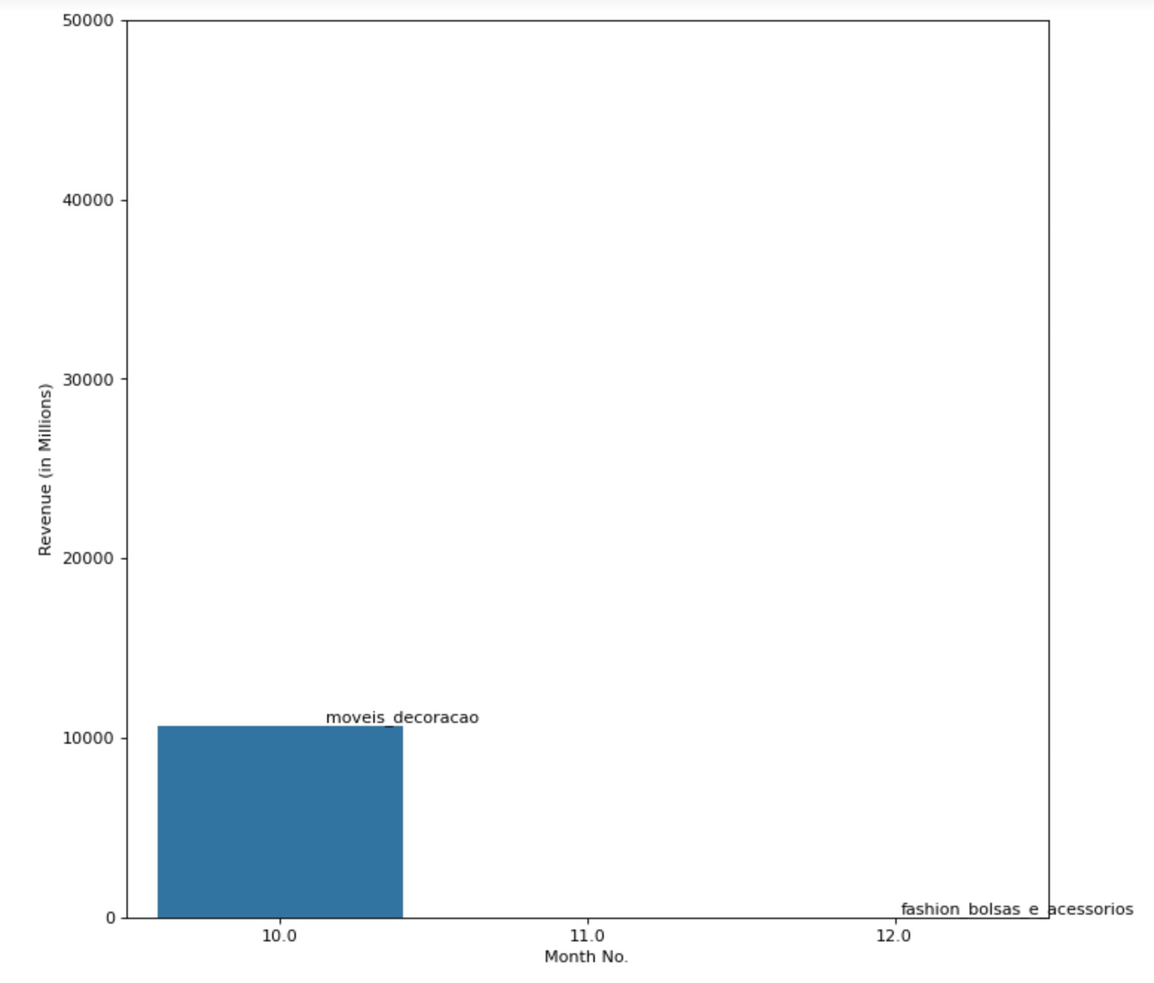
Bar Graph representing Monthly Revenue for 2016

Slide 16
Exploratory Data Analysis (Product Category wise) for 2016
Category with the Highest Revenue
Furniture Design - 153085.00

Slide 17
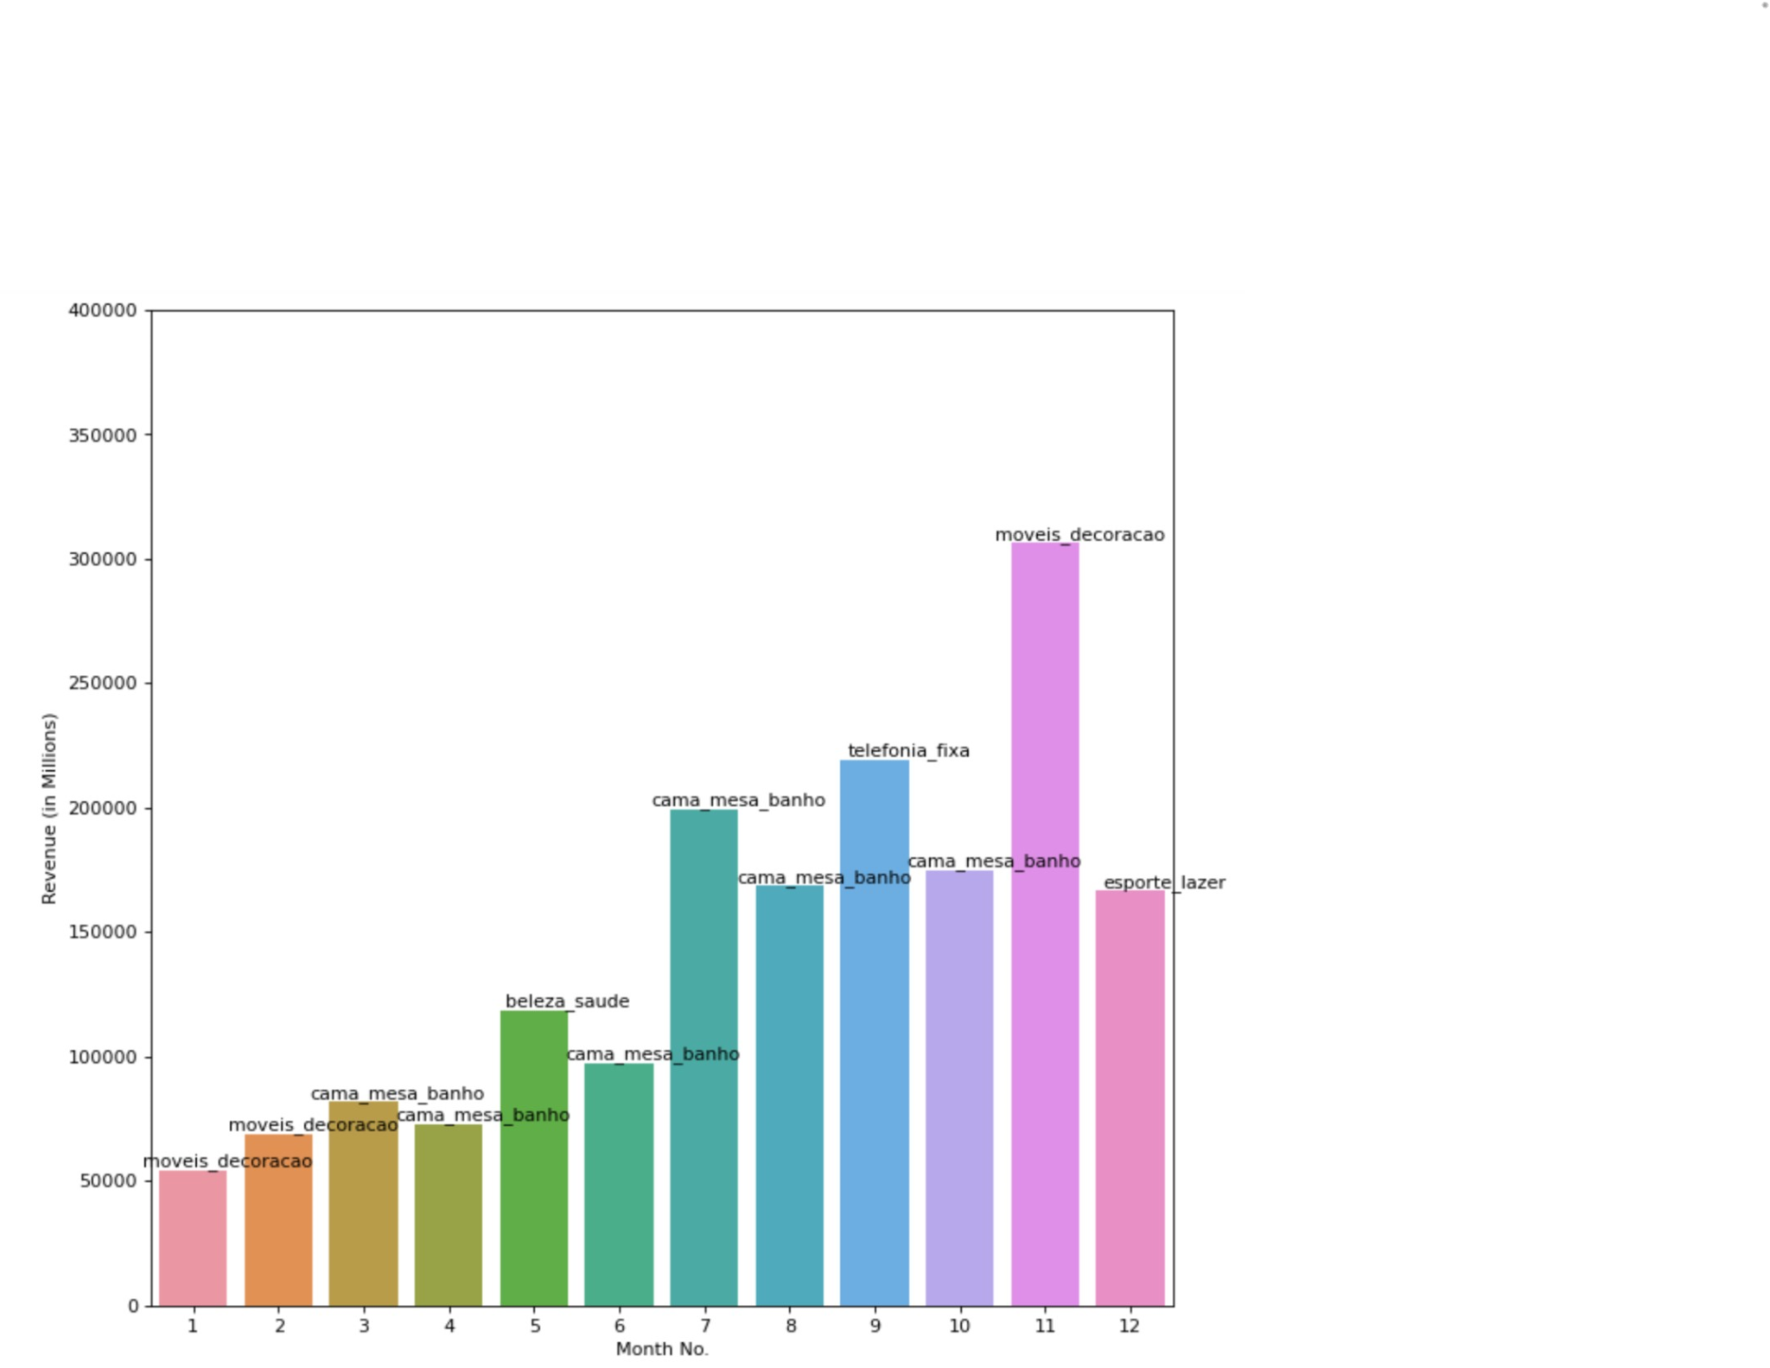
Bar Graph representing Monthly Revenue for 2017

Slide 18
Exploratory Data Analysis (Product Category wise) for 2017
Category with the Highest Revenue
Furniture Design - 10699.61

Slide 19
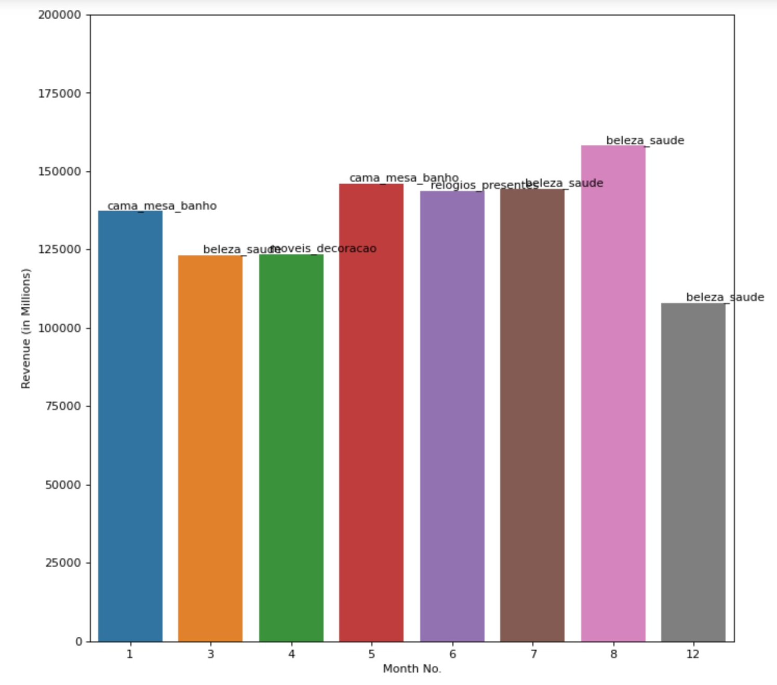
Bar Graph representing Monthly Revenue for 2018

Slide 20
Exploratory Data Analysis (Product Category wise) for 2018
Category with the Highest Revenue
Beauty & Health - 158063.72

Slide 21
Data Preparation
Removal of rows with null values
Grouping datasets having a common variable

Slide 22
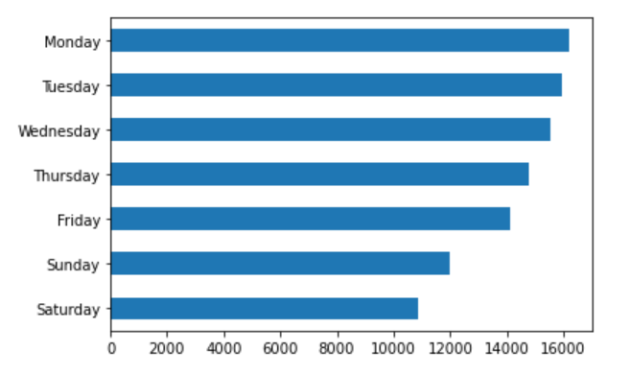
Weekly sales analysis
Notes:
This is the weekly sales analysis which surprisingly shows lesser sales during the weekend

Slide 23
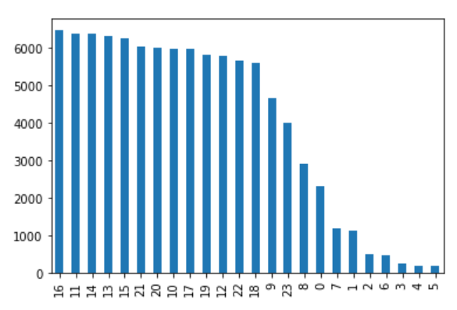
Hourly sales analysis
Notes:
High sales from 9 am to 11pm

Slide 24
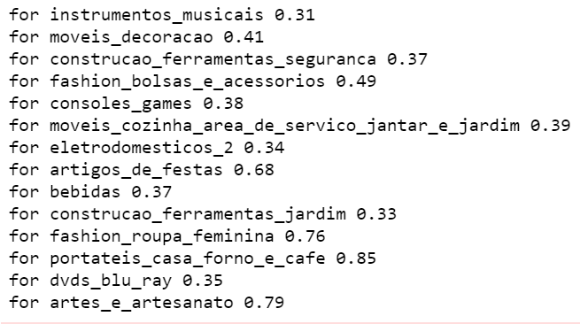
Correlation between sales and images
Notes:
we also observed the correlarion between photos and sales for a particular product category..we noted a positive correlation between them for products with high importance (musical instruments,female fashion)/customers found it necessary to see the images of certain prods to buy them..but not so for lesser important prods like computer accessories,houseware,sports leisure.

Slide 25
3
Machine Learning

Slide 26

Monthly Revenue Prediction
Reasons for using Prophet
it can capture seasonal variations very well
the user does not need to specify any parameters
auto ARIMA does not work well with seasonal variations
ARIMA would work well only if the user specifies the correct parameters

Slide 27
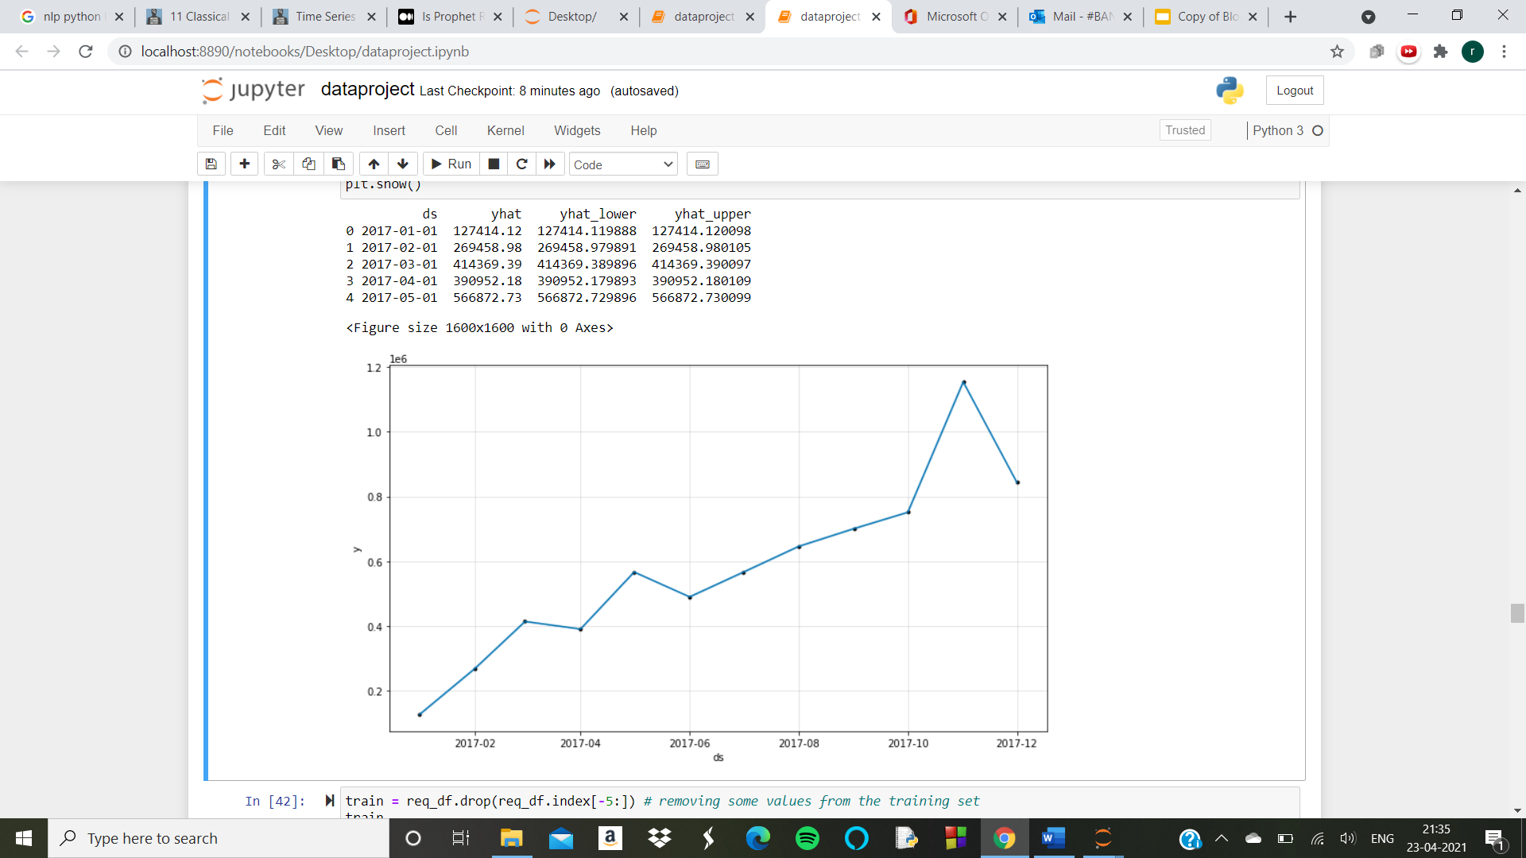
Machine learning
75%
25%
Venus
Mars
Allowing the model to learn from 2017 data

Slide 28
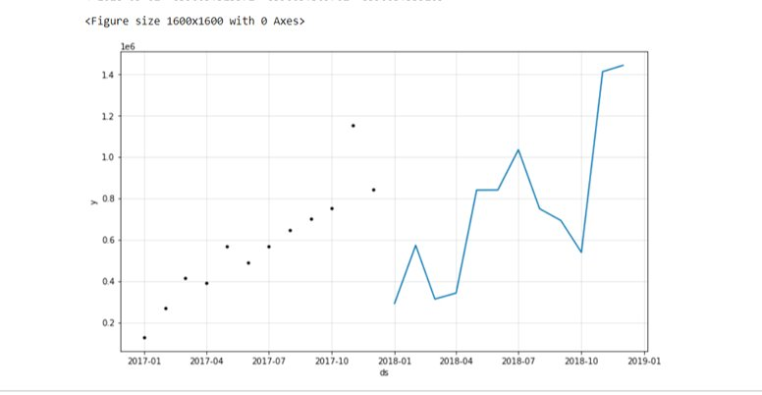
Prediction for 2018​

Slide 29
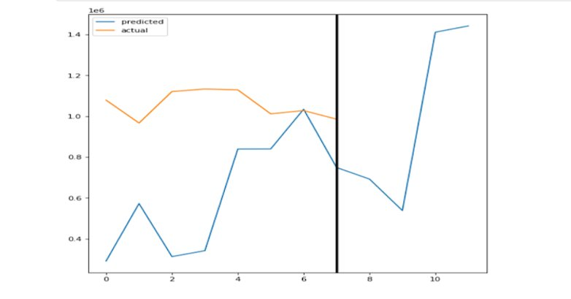
Predicting on 2018 data - result​

Slide 30
RFM Analysis
Elbow method to find the ideal number of clusters for segmentation
RFM filters customers into various groups for the purpose of better service.
A higher score is better,a score of 444 shows that the customer is loyal and is the best score.
Notes:
RFM analysis is a data driven customer behavior segmentation technique. RFM stands for recency, frequency, and monetary value. The idea is to segment customers based on when their last purchase was, how often they've purchased in the past, and how much they've spent overall.
We used the elbow method to find the ideal number of clusters for segmentation.It groups the customers on the basis of their previous purchase transactions. I.e How recently, how often, and how much did a customer buy. RFM filters customers into various groups for the purpose of better service.

Slide 31
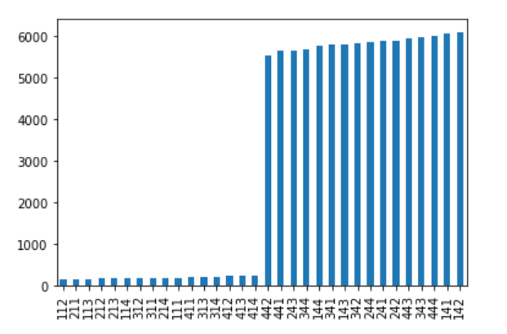
Notes:
This plot gives us a clear understanding of the count of customers in each category.The arrow points towards 444 which consists of the most loyal customers.

Slide 32
4
Outcome

Slide 33
Outcome of the project
Able to segment customers based on their activity through calculated rfm value
This will help improve the marketing strategy
It has solved our original problem of increasing revenue
We had expected that maximum orders would come during the weekends when people are at home,but surprisingly weekends recorded minimum sales
Notes:
We were able to identify our loyal customers who had the highest rfm value,so that we can give them special offers and identify customers with vey little activity,which allows us to focus on bringing them back by sending them promotionional mails and discounts.This will help us improve our marketing strategy..We had expected that maximum orders would come during the weekends when people are at home,but surprisingly weekends recorded minimum sales,
This was able to solve the problem as we have been able to come up with strategies to increase the sales of the company ….
These observations have contributed in solving our original problem as now we know where the company has to step up with their marketing efforts

Slide 34
5
Data-driven insights

Slide 35
Data driven insights
Company should ramp up their marketing efforts
The company should cater to the products the locals are more likely to purchase to increase sales during the festive season
Vouchers to encourage inactive customers to come back
Notes:
We had expected that maximum orders would come during the weekends when people are at home,but surprisingly weekends recorded minimum sales,which suggest that the company has to ramp up their marketing efforts on weekends as ideally people have more time during the weekends and this will increase their sales. It is possible to reach the entire Brazilian population through the country's hundreds of TV channels. Everyone watches television, especially during sports events that the country takes part in. we can see high sales in nov,this is due to Christmas shopping.. we also saw lower sales in feb during the carnival time in brazil.there are a lot of celebrations,therefore the company should cater to the things that they would purchase since they prefer their regional items like handicrafts,traditional folk costumes.more photos should be given for products as people prefer seeing the image .It is essential for the company to observe the market they are catering to.

Slide 36
6
Conclusion

Slide 37
Conclusion
Our analysis has been able to provide a solution for our problem statement.

Slide 38
References
•https://towardsdatascience.com/find-your-best-customers-with-customer-segmentation-in-python-61d602f9eee6
•https://www.eightleaves.com/2011/01/using-rfm-to-identify-your-best-customers
•https://www.optimove.com/resources/learning-center/rfm-segmentation
•https://www.constructdigital.com/insight/b2c-e-commerce-know-the-customers-you-will-never-meet

